Slide 1
The Battle of the Neighborhoods
Priya Dhawka
February 2020

Slide 2
Background
San Francisco is the 15th most populous city in the US
San Francisco has the largest concentration of tech companies in the US
Concerns about a growing tech workforce include gentrification of historically poor immigrant neighborhoods
Past SF neighborhoods which have gentrified include the Mission District (Inner Mission neighborhood)
Effects of gentrification include rising rent costs and a reduction in affordable housing

Slide 3
Problem Description & Interest
This report seeks to understand how the “signs” of gentrification can be used to confirm whether a neighborhood is “at risk” of gentrification
It chooses the smallest neighborhood by population size, Chinatown, which is also the oldest Chinatown in the US and compares it with the largest neighborhood as well as with neighborhoods that have already experienced some sort of gentrification
This analysis might be interesting for urban planners, sociologists and young workers or immigrants moving to San Francisco - gentrified neighborhoods often have better infrastructure and housing units, despite the associated costs

Slide 4
Data Sources & Methodology
We use the following definition of gentrification in our analysis:
Gentrification as the process of “changing the character of a neighborhood through the influx of more affluent residents and businesses”
Our data is taken from http://www.healthysf.org/bdi/outcomes/zipmap.htm
We select the following neighborhoods to compare: Chinatown, Japantown, Inner Mission, the Market and Hill neighborhoods
We use the Foursquare API to get the most common venues in each neighborhood

Slide 5
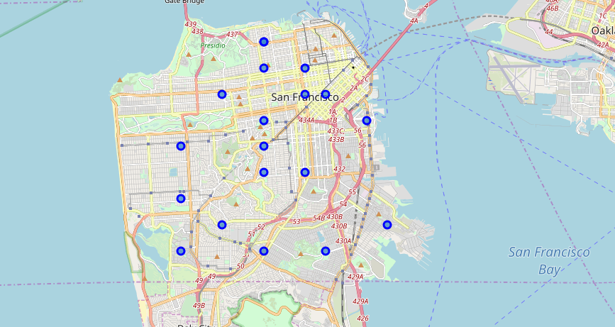
Initial Visualization of SF (All neighborhoods)

Slide 6
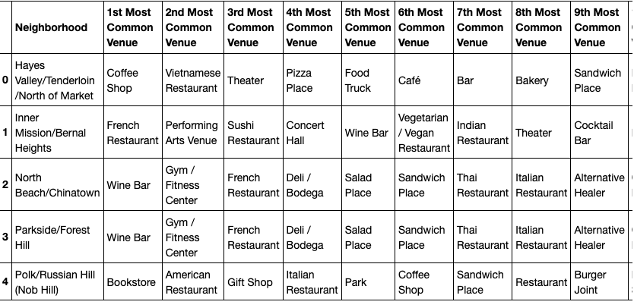
Using the Foursquare API to retrieve most common venues

Slide 7
Results: Using KMeans Clustering
Using the KMeans clustering algorithm, we cluster our 8 neighborhoods into 3 clusters - “gentrified, gentrifying and least gentrified”
We use the folium and matplotlib libraries to visualize the result of our KMeans clustering on a map of San Francisco
We can further analyze each individual cluster for understanding what the markers for gentrification can be in terms of the most common venues for each cluster

Slide 8
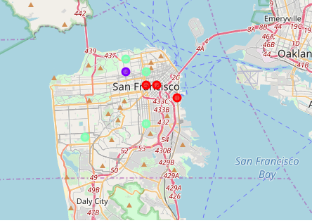
Resulting KMeans Map of Clusters

Slide 9
Conclusion & Discussion
The KMeans algorithm returns 3 clusters, with Chinatown placed in a cluster with gentrifying neighborhoods, while the other ethnic neighborhood we considered, Japantown, is placed in its own cluster
The neighborhood having already experienced the most gentrification in terms of demographics, housing costs and infrastructure (South of Market) surprisingly has “Chinese Restaurant” as the most common venue
Since SF only has 21 neighborhoods and we further narrowed the number of neighborhoods, there are not many similarities in our clustered neighborhoods
We can conduct further analysis to understand gentrification with data from cities with a larger number of neighborhoods as well as add in housing costs and demographic breakdown for more indicators of gentrification

Slide 10
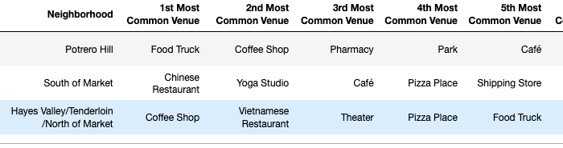
Conclusion
Cluster 0: The “gentrified cluster”

Slide 11
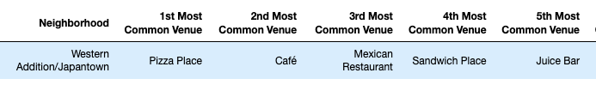
Conclusion
Cluster 1: The “outlier”

Slide 12
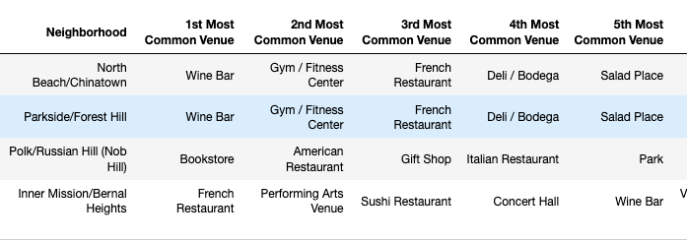
Conclusion
Cluster 2: The “gentrifying” cluster

Slide 13
Thank you!

